Slide 1

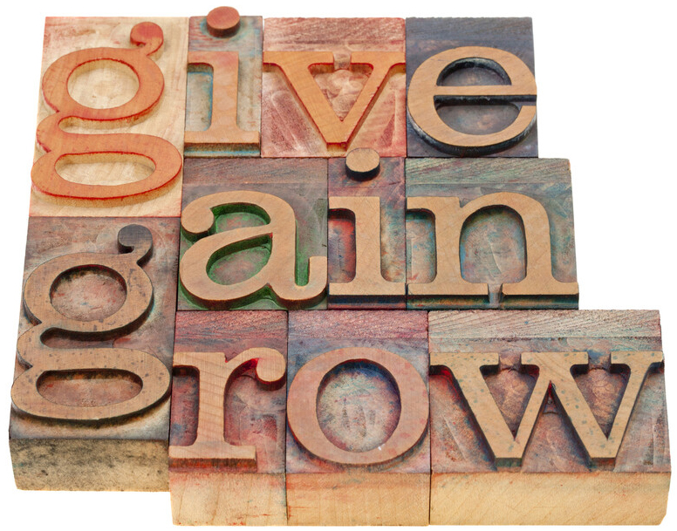
YEAR-END GIVING
A Guide for Churches and Individuals
Gary Melville, ChFC, CAP
Donor Development Consultant
gmelville@umfne.org
508.641.5568
Pam DiMartino, CPA, CFO
Director of Gift Planning
pamd@umfne.org
800.595.4347 x112
www.umfne.org

Slide 2
Agenda
  For the Church
  For the Individual & Family

Slide 3
FOR THE CHURCH
Promote year-end giving
Tell the ministry stories
Celebrate the successes
Say “THANK YOU” in creative ways

Slide 4
  PROMOTE YEAR-END GIVING
  Make this part of your year-round strategy.
  Tie it to mission, a special project, or a current need.
  Adjust the message for economic opportunities or constraints.

Slide 5
  TELL THE MINISTRY STORIES
  Select one or two stories on which to focus.
  Use video and pictures – a testimony is BEST.
  Keep it short but give the important details.
  Focus on the IMPACT.
  Share through all communication channels.

Slide 6
  CELEBRATE THE SUCCESSES
  Highlight the year.
  Share new programs, new members, etc.
  Lift up the work of committee and ministry teams.
  Focus on the IMPACT.

Slide 7
  SAY “THANK YOU” IN CREATIVE WAYS
  Write notes of appreciation on giving statements.
  Acknowledge legacy gifts, both past and present.
  Invite people to share their generosity story.
  Liturgical calendar: Advent, Epiphany, Lent, Etc.

Slide 8
  HOW THE FOUNDATION CAN HELP
  Gift Planning Services
  “Putting Your House In Order”
  Donor Advised & Donor Endowed Funds
  Charitable IRA Rollover
  Charitable Gift Annuities

Slide 9
FOR THE INDIVIDUAL OR FAMILY
      Review philanthropic goals and giving
      Financial plan check-up
      Evaluate your tax situation
      Act on your plans:
      What is my legacy?
      How can I give?

Slide 10
  REVIEW PHILANTHROPIC GOALS AND GIVING
  Write a personal or family mission statement.
  Evaluate the charities you supported this year.
  Are there new charities to support or remove?
  Are you on target to meet your giving goals?
  What has God placed on your heart?

Slide 11
  FINANCIAL PLAN CHECK-UP
  How does your charitable giving enhance your financial plan?
  Do you need to meet with your advisors?
  Is it time to update your estate plans?

Slide 12
  EVALUATE YOUR TAX SITUATION
  Work with your tax advisor.
  Rebalance strategy: sell losses and give gains.
  Bundle charitable gifts to receive charitable gift deductions.

Slide 13
  WHAT IS MY LEGACY?
  How will my estate plan reflect my faith?
  How can I maximize my gifts to family and the organizations that bring meaning and purpose to my life?
  Express gratitude for life’s blessings.

Slide 14
HOW CAN I GIVE?
  Charitable IRA rollover
  Gifting appreciated securities
  Donor advised funds
  Split interest gifts

Slide 15
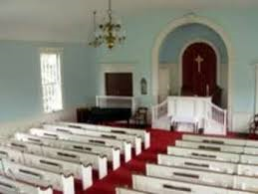

CHARITABLE IRA ROLLOVER
BANK OR IRA TRUSTEE
Bill has an $800,000 IRA
He is 74 years old
His RMD is $33,130.45
Bill & Ruth plan to give $5,000 to church
Bank sends IRA distribution of $5,000 directly to church
Taxable income is reduced by $5,000.
Church receives $5,000 IRA Gift – TAX-FREE!
Bill and Ruth save $1,100 in taxes!

Slide 16
GIFTING APPRECIATED SECURITES
DONOR GIFTS:
stock/mutual
funds
FOUNDATION:
sells and distributes
proceeds
FOUNDATION:
sends gift
acknowledgement
letters
The donor gifts $50,000 of Apple stock with a $10,000 cost basis.
Could save $6,000 capital gains tax.
  CHURCH
Notes:
"GIVE IT TWICE" TRUST
In this illustration, a family with a medium-sized estate decides to benefit both the family and charity. After mother and father pass away the estate is transferred into a trust. This trust pays income to family members until a total of $500,000 has been distributed as income. Typically, this will take from twelve to fifteen years. After the estate has been given as income to family, the principal is then distributed to the charity. While the family will have to pay tax on the income, it is an excellent way for parents to remember family for a period of years and distribute the balance of their estate to a charity.

Slide 17
THE DONOR ADVISED FUND (DAF)
DONOR GIFTS:
cash/stock/
real estate
FOUNDATION
DAF
Family and friends
make donations
Donor/advisor makes
grant recommendations
  CHURCH
Notes:
"GIVE IT TWICE" TRUST
In this illustration, a family with a medium-sized estate decides to benefit both the family and charity. After mother and father pass away the estate is transferred into a trust. This trust pays income to family members until a total of $500,000 has been distributed as income. Typically, this will take from twelve to fifteen years. After the estate has been given as income to family, the principal is then distributed to the charity. While the family will have to pay tax on the income, it is an excellent way for parents to remember family for a period of years and distribute the balance of their estate to a charity.

Slide 18
CHARITABLE GIFT ANNUITY (CGA)
DONOR GIFTS:
cash/stock/
real estate
FOUNDATION
CGA
Fixed income payments
for one or two lives
Income tax deduction
Fixed payments
Donor Endowed Fund
or
CHURCH
Notes:
"GIVE IT TWICE" TRUST
In this illustration, a family with a medium-sized estate decides to benefit both the family and charity. After mother and father pass away the estate is transferred into a trust. This trust pays income to family members until a total of $500,000 has been distributed as income. Typically, this will take from twelve to fifteen years. After the estate has been given as income to family, the principal is then distributed to the charity. While the family will have to pay tax on the income, it is an excellent way for parents to remember family for a period of years and distribute the balance of their estate to a charity.

Slide 19
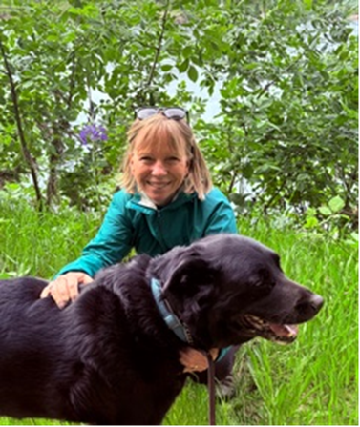
  Joyfully Giving Generous Gratitude:
  Thanking Those Who Give
  With Cesie Delve Scheuermann
  Nov 19th at 12:30 and 20th at 7:00pm
      Why thanking is important
      How to write a great thank you letter
      Other ways to thank members of your congregation
Cesie Delve Scheuermann has loved learning about ways to thank people who give. She’s been writing the stewardship blog “Inspiring Generosity” for more than ten years. She is the Stewardship Consultant for the OR-ID Annual Conference (where she also served as the Conference Lay Leader). In addition, she is a Senior Ministry Strategist for Horizons Stewardship.

